Slide 1
Kubernetes Installation and Configuration Fundamentals
INTRODUCTION AND EXPLORING KUBERNETES ARCHITECTURE

Slide 2

Course Overview
Introduction
Exploring Kubernetes Architecture Installing and Configuring Kubernetes Working with Your Kubernetes Cluster

Slide 3

Overview
What is Kubernetes?
Exploring Kubernetes Architecture
Cluster Components
Networking Fundamentals

Slide 4
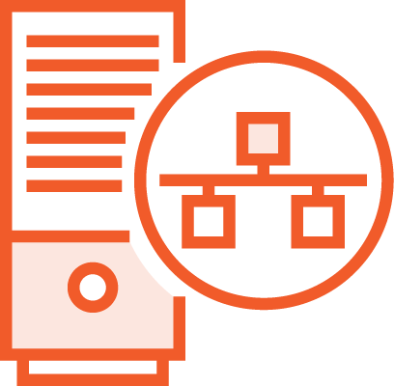

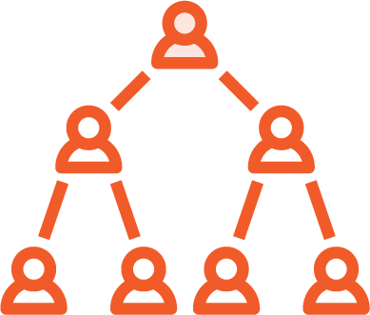
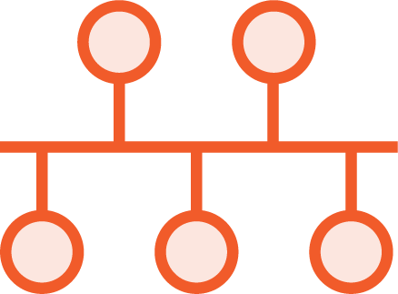
What Is Kubernetes?
Container Orchestrator
Workload Placement
Infrastructure Abstraction
Desired State

Slide 5



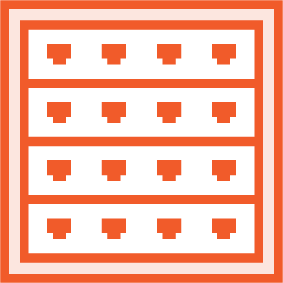
Benefits of Using Kubernetes
Speed of deployment
Ability to absorb change quickly
Ability to recover quickly
Hide complexity in the cluster

Slide 6
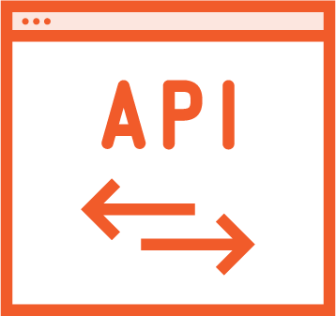
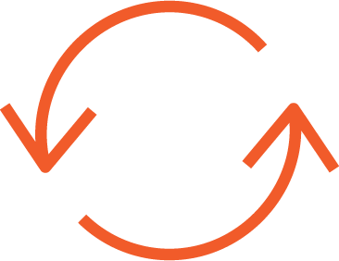
Kubernetes Principles
Desired State/ Declarative Configuration
Controllers/
Control Loops
Kubernetes API/The API Server

Slide 7
Kubernetes API
API Objects
Collection of primitives to represent your system’s state
Enables configuration of state Declaratively
Imperatively

Slide 8
Kubernetes API Server
RESTful API over HTTP using JSON
The sole way to interact with your cluster
The sole way Kubernetes interacts with your cluster
Serialized and persisted

Slide 9
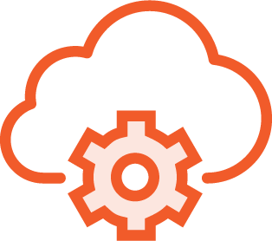

Kubernetes API Objects
Pods
Controllers
Services
Storage
Not an exhaustive list, but these are the key players

Slide 10
Pods
One or more containers
It’s your application or service The most basic unit of work Unit of scheduling
Ephemeral - no Pod is ever “redeployed” Atomicity - they’re there or NOT

Slide 11
Pods - Continued
Kubernetes’ job is keeping your Pods running
More specifically keeping the desired state State - is the Pod up and running
Health - is the application in the Pod running Probes

Slide 12
So how does Kubernetes manage my Pods’ state?

Slide 13
Controllers
Defines your desired state
Create and manage Pods for you Respond to Pod state and health ReplicaSet
Number of replicas
Deployment
Manage rollout of ReplicaSets
Many more…and not just Pods

Slide 14
So how does Kubernetes add persistency to all this ephemerality?

Slide 15
Services
Adds persistency to our ephemeral world
Networking abstraction for Pod access IP and DNS name for the Service
Dynamically updated based on Pod lifecycle Scaled by adding/removing Pods
Load balancing

Slide 16
What about my data?
Where’s that stored in Kubernetes?

Slide 17
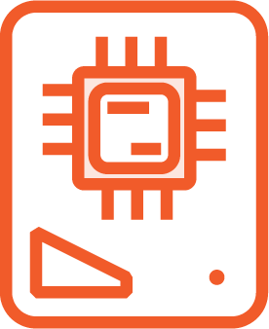
Storage in Kubernetes
Volumes
Persistent Volume
Persistent Volume Claim

Slide 18
Exploring Kubernetes Architecture

Slide 19
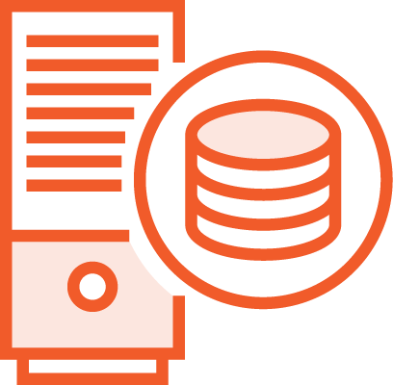
Cluster Components
Control Plane Node
Node

Slide 20
Control Plane Node
Master Node
Control Plane Node

Slide 21

Control Plane Node
etcd
Control Plane Node
API Server
Scheduler
kubectl
Controller Manager

Slide 22
Control Plane Components
API Server
etcd Scheduler
Controller Manager
Central |  | Persists State |  | Watches API Server
Simple |  | API Objects |  | Schedules Pods
RESTful |  | Key-value |  | Resources
Updates etcd |  |  |  | Respects contraints
Controller Loops
Lifecycle functions and desired state
Watch and update the API Server
ReplicaSet

Slide 23
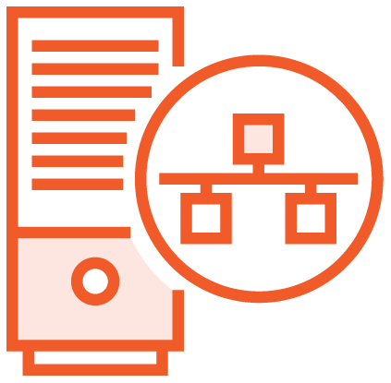
Nodes
etcd
Control Plane Node
API Server
Scheduler
Controller Manager
Kubelet
Node
Kube-proxy
Container Runtime

Slide 24
Nodes
Kubelet
kube-proxy
Container Runtime
Monitors API Server for changes
iptables
Downloads images & runs containers
Responsible for Pod Lifecycle
Implements Services
Container Runtime Interface (CRI)
Reports Node & Pod state
Routing traffic to Pods
containerd
Pod probes
Load Balancing
Many others…

Slide 25
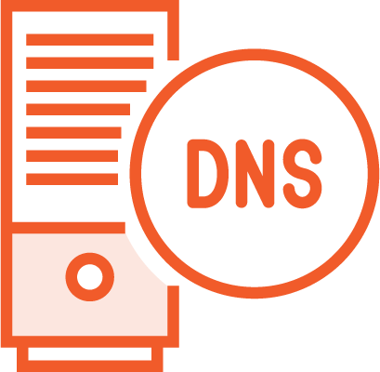
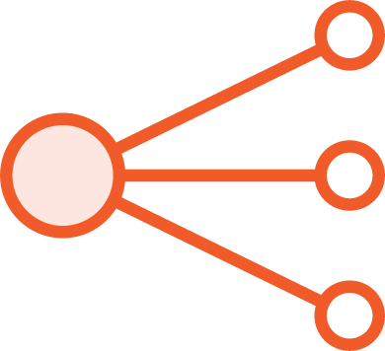

Cluster Add-on Pods
DNS
Ingress
Dashboard

Slide 26
Pod Operations
etcd
Control Plane Node
API Server
Scheduler
kubectl
Controller Manager
Kubelet
Kube-proxy
Pod
Pod
Pod
Node
Container Runtime
Kubelet
Kube-proxy
Pod
Node
Container Runtime

Slide 27

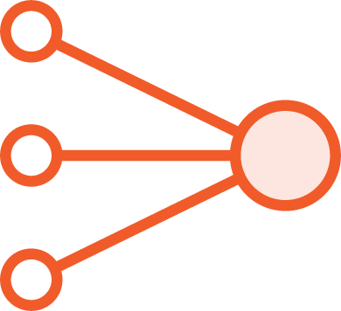

Services
Pod
Pod
Pod
HTTP
Pod
Pod
Cluster
Service

Slide 28
Kubernetes Networking Fundamentals

Slide 29
Kubernetes Networking Requirements
Pods on a Node can communicate with all Pods on all Nodes without Network Address Translation (NAT)
Agents on a Node can communicate with all Pods on that Node

Slide 30
Networking Fundamentals
Pod
IP
Pod
IP
Kube-proxy
Bridge
HTTP
Layer 2 or 3
Pod
Service
Inside a Pod
Pod to Pod within a Node
Pod to Pod on another Node
External Services
localhost
Kube-proxy
Pod
IP

Slide 31
Summary
What is Kubernetes?
Exploring Kubernetes Architecture
Cluster Components
Networking Fundamentals

Slide 32
What’s Next!
Installing and Configuring Kubernetes

